Slide 1
Multiple Access Techniques II
Course Code: CSC 3116
Course Title: Computer Networks
Dept. of Computer Science
Faculty of Science and Technology
Lecturer No: | 4 | Week No: | 4 | Semester: | Summer 19-20
Lecturer: | Md. Sakir Hossain, Email: sakir.Hossain@aiub.edu

Slide 2
Lecture Outline
ALOHA
CSMA
CSMA/CD
CSMA/CA

Slide 3
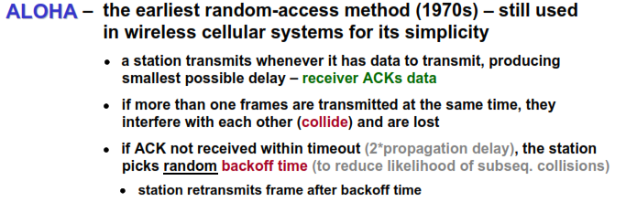
ALOHA
Introduction

Slide 4
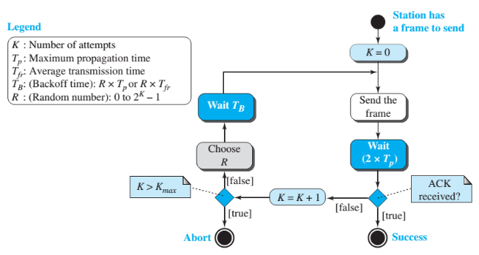
ALOHA….
Algorithm
Fig. 1 Flow chart of ALOHA

Slide 5
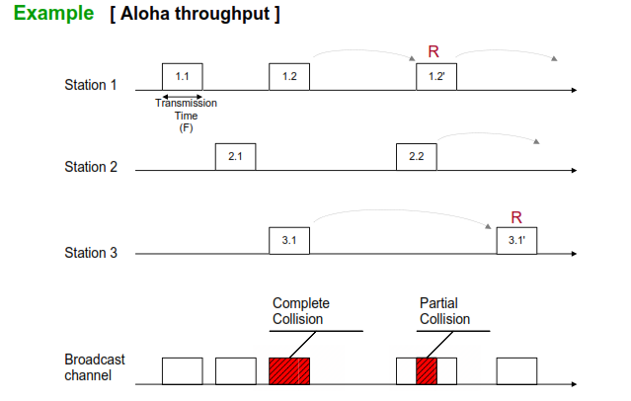
ALOHA….
Collision
R= Transmission Rate
Fig. 2 Collision in ALOHA

Slide 6
ALOHA….
Throughput
The throughput is the fraction of time, the channel carries useful information, namely non-colliding packets.
Under all number of frames, the throughput, S, is just the product of average number of frames, G and the probability, P, of a transmission succeeding—that is,
S = GP
Consider a packet scheduled for transmission at some time ‘t’. This packet will be successful if no other packet is scheduled for transmission in the interval (t-T, t+T) (this period of 2T is called the vulnerable period). The probability of this happening, that is, the probability of success, is that no packet is scheduled in an interval of length 2T.
2T
t - T
t
t + T

Slide 7
ALOHA….
Throughput
Fig. 3 Vulnerable time of ALOHA

Slide 8
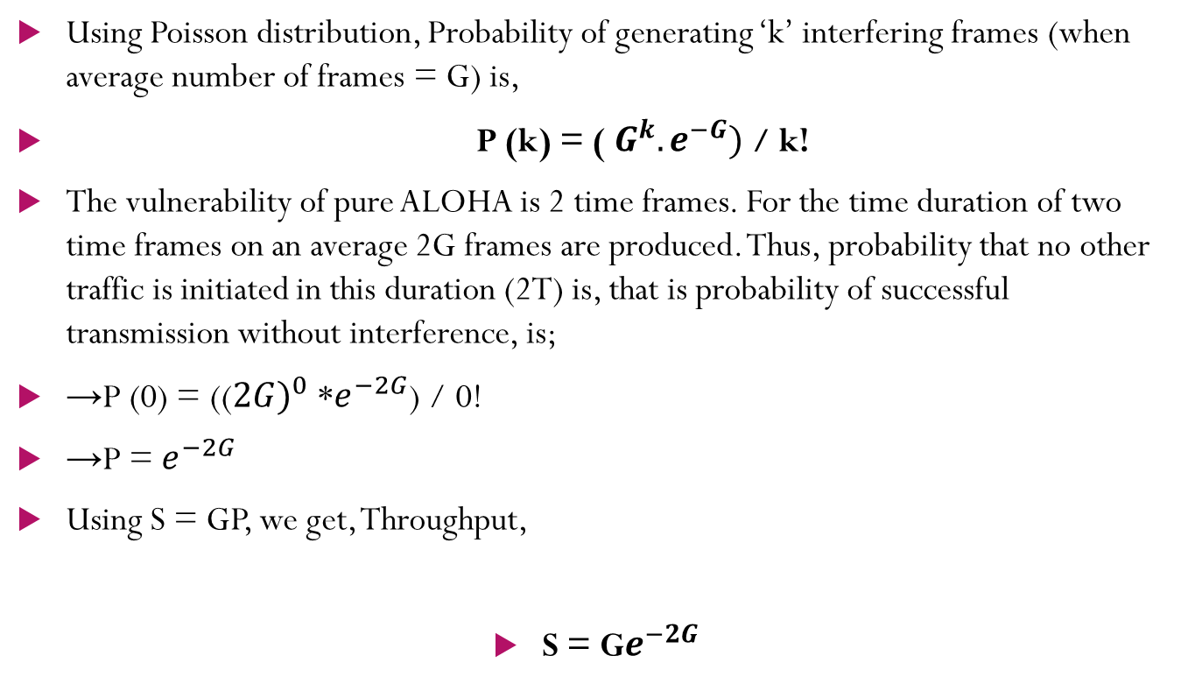
ALOHA….
Throughput
Using Poisson distribution, Probability of generating ‘k’ interfering frames (when average number of frames = G) is,
P (k) = ( $G^{k}.e^{−G})$ / k!
The vulnerability of pure ALOHA is 2 time frames. For the time duration of two time frames on an average 2G frames are produced. Thus, probability that no other traffic is initiated in this duration (2T) is, that is probability of successful transmission without interference, is;
→P (0) = ((${2G)}^{0}$ *$e^{−2G}$) / 0!
→P = $e^{−2G}$
Using S = GP, we get, Throughput,
S = G$e^{−2G}$

Slide 9
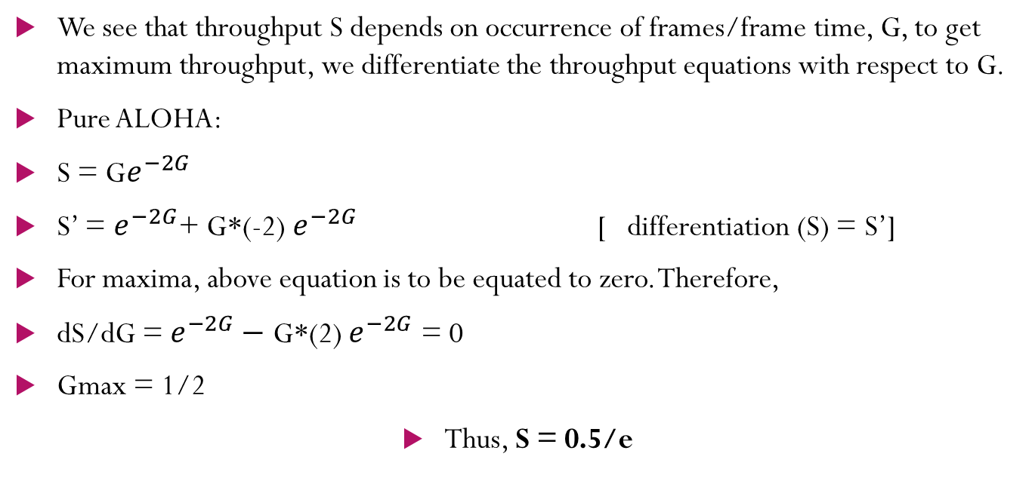
ALOHA….
Throughput
We see that throughput S depends on occurrence of frames/frame time, G, to get maximum throughput, we differentiate the throughput equations with respect to G.
Pure ALOHA:
S = G$e^{−2G}$
S’ = $e^{−2G}$+ G*(-2) $e^{−2G}$ [ differentiation (S) = S’]
For maxima, above equation is to be equated to zero. Therefore,
dS/dG = $e^{−2G}−$ G*(2) $e^{−2G}$ = 0
Gmax = 1/2
Thus, S = 0.5/e

Slide 10
Carrier Sense Multiple Access
Introduction
CSMA was developed to overcome the problems of ALOHA i.e. to minimize the chances of collision.
CSMA is based on the principle of “carrier sense”.
The station sense the carrier or channel before transmitting a frame.
It means the station checks whether the channel is idle or busy.
The chances of collision reduces to a great extent if a station checks the channel before trying to use it.

Slide 11
Carrier Sense Multiple Access
CSMA
The chances of collision still exists because of propagation delay.
The frame transmitted by one station takes some time to reach the other station.
In the meantime, other station may sense the channel to be idle and transmit its frames.
This results in the collision.
Fig. 4 Flow chart of CSMA

Slide 12
Carrier Sense Multiple Access
Classification
What should a station do if the channel is busy? What should a station do if the channel is idle?
Three methods have been devised for CSMA:
I-persistent method,
the nonpersistent method
the p-persistent method

Slide 13
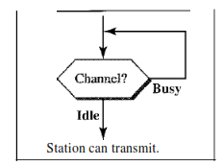
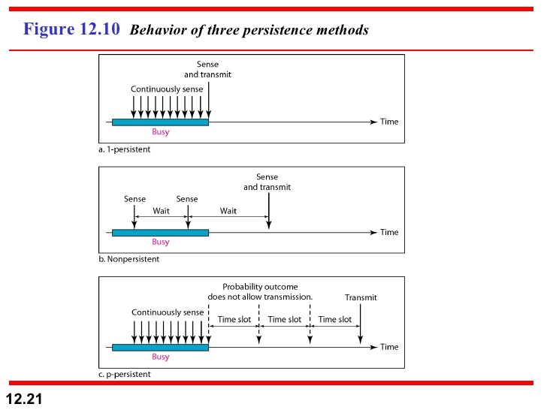
Carrier Sense Multiple Access
1-persistent
1-Persistent: The 1 (one) -persistent method is simple and straightforward. In this method, after the station finds the line idle, it sends its frame immediately (with probability 1).
This method has the highest chance of collision because two or more stations may find the line idle and send their frames immediately.
Fig. 5 Carrier sense in 1-persistent
Fig. 6 Flow chart of 1-persistent

Slide 14
Carrier Sense Multiple Access
Nonpersistent
Nonpersistent: In the nonpersistent method, a station that has a frame to send senses the line. If the line is idle, it sends immediately. If the line is not idle, it waits a random amount of time and then senses the line again.
The nonpersistent approach reduces the chance of collision because it is unlikely that two or more stations will wait the same amount of time and retry to send simultaneously.
However, this method reduces the efficiency of the network because the medium remains idle when there may be stations with frames to send.

Slide 15
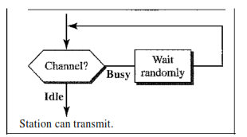
Carrier Sense Multiple Access
Nonpersistent
Fig. 7 Carrier sense in nonpersistent
Fig. 8 Flow chart of nonpersistent

Slide 16
Carrier Sense Multiple Access
P-Persistent
p-Persistent: The p-persistent method is used if the channel has time slots with a slot duration equal to or greater than the maximum propagation time. The p-persistent approach combines the advantages of the other two strategies. It reduces the chance of collision and improves efficiency.
In this method, after the station finds the line idle it follows these steps:
1. With probability p, the station sends its frame.
2. With probability q = 1 - p, the station waits for the beginning of the next time slot and checks the line again.
a. If the line is idle, it goes to step 1.
b. If the line is busy, it acts as though a collision has occurred and uses the
back­ off procedure.

Slide 17
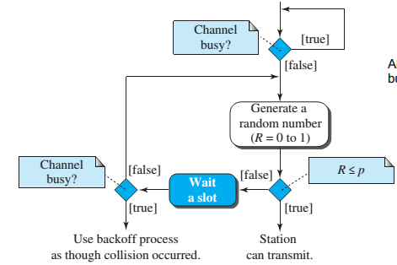

Carrier Sense Multiple Access
P-Persistent
Fig. 9 Carrier sense in p-persistent
Fig. 10 Flow chart of p-persistent

Slide 18
CSMA/CD
In CSMA/CD, the station that sends its data on the channel, continues to sense the channel even after data transmission.
If collision is detected, the station aborts its transmission and waits for a random amount of time & sends its data again.
As soon as a collision is detected, the transmitting station release a jam signal.
Jam signal alerts other stations. Stations are not supposed to transmit immediately after the collision has occurred.
Fig. 11 Flow chart of CSMA/CD

Slide 19
CSMA/CA
Introduction
Carrier sense multiple access/collision avoidance (CSMA/CA) protocol is used in wireless networks because they cannot detect the collision.
So, the only solution is collision avoidance.
Worked based on three strategies
Inter Frame Space
Contention Window
Acknowledgements
Fig. 12 Flow chart of CSMA/CA

Slide 20
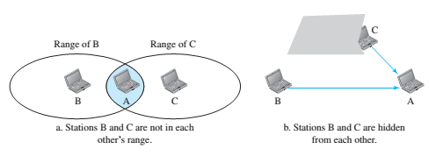
CSMA/CA
Introduction
Wireless Networks
CSMA/CA is used. CSMA/CD cannot be used because
CSMA/CD requires continuous transmission and reception for collision detection. Thus require full-duplex operation, which can not be supported in wireless due to short battery life
Difficult to detect may not be detected because of obstacle or range problem
The distance between stations can be great. Signal fading could prevent a station at one end from hearing a collision at the other end.
Fig. 13 Illustration of difficulties
in collision detection in wireless
networks

Slide 21
Topic Heading..
Topic sub heading..
This protocol is used in wireless networks because they cannot detect the collision.
So, the only solution is collision avoidance.
It avoids the collision by using three basic techniques:
Interframe Space (IFS)
Contention Window
Acknowledgements

Slide 22
CSMA/CA
Interframe Space
Whenever the channel is found idle, the station does not transmit immediately.
It waits for a period of time called Interframe Space (IFS).
When channel is sensed idle, it may be possible that some distant station may have already started transmitting.
Therefore, the purpose of IFS time is to allow this transmitted signal to reach its destination.
If after this IFS time, channel is still idle, the station can send the frames

Slide 23
CSMA/CA
Contention window
Contention window is the amount of time divided into slots.
Station that is ready to send chooses a random number of slots as its waiting time.
The number of slots in the window changes with time.
It means that it is set of one slot for the first time, and then doubles each time the station cannot detect an idle channel after the IFS time.
In contention window, the station needs to sense the channel after each time slot [1].

Slide 24
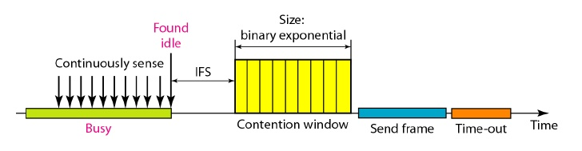
CSMA/CA
Acknowledgement
Despite all the precautions, collisions may occur and destroy the data.
Positive acknowledgement and the time-out timer helps guarantee that the receiver has received the frame.
Fig. 14 Carrier sense in contention window

Slide 25
References
[1] B. A. Forouzan, Data Communication and Networking, 5th ed., The McGraw-Hill Companies, Inc., USA, 2013, pp. 326-339.

Slide 26
Recommended Books
Data Communications and Networking, B. A. Forouzan, McGraw-Hill, Inc., Fourth Edition, 2007, USA.
Computer Networking: A Top-Down Approach, J. F., Kurose, K. W. Ross, Pearson Education, Inc., Sixth Edition, USA.
Official Cert Guide CCNA 200-301 , vol. 1, W. Odom, Cisco Press, First Edition, 2019, USA.
CCNA Routing and Switching, T. Lammle, John Wily & Sons, Second Edition, 2016, USA.
TCP/IP Protocol Suite, B. A. Forouzan, McGraw-Hill, Inc., Fourth Edition, 2009, USA.
Data and Computer Communication, W. Stallings, Pearson Education, Inc., Tenth Education, 2013, USA.

